Slide 1

Course Code: MATH 211
Course Title: MATH III
Lecture 11 (Singularity)
Tazin Tamanna
Lecturer in Mathematics
Department of Science and Humanities
M.Sc. in Applied Mathematics (KU)
B.Sc. in Mathematics (KU)

Slide 2
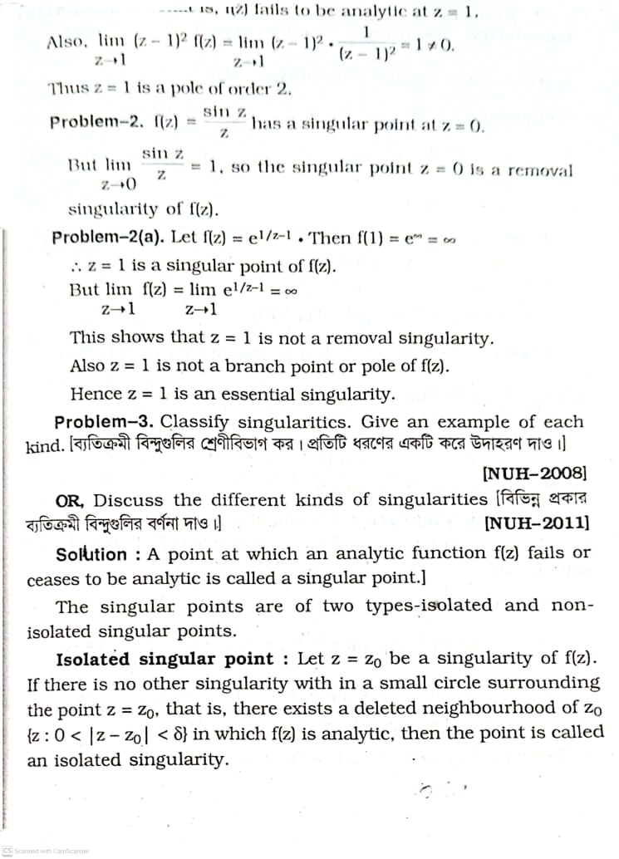
SINGULARITY
A point at which a function f(z) fails to be analytic.
Classification

Slide 3
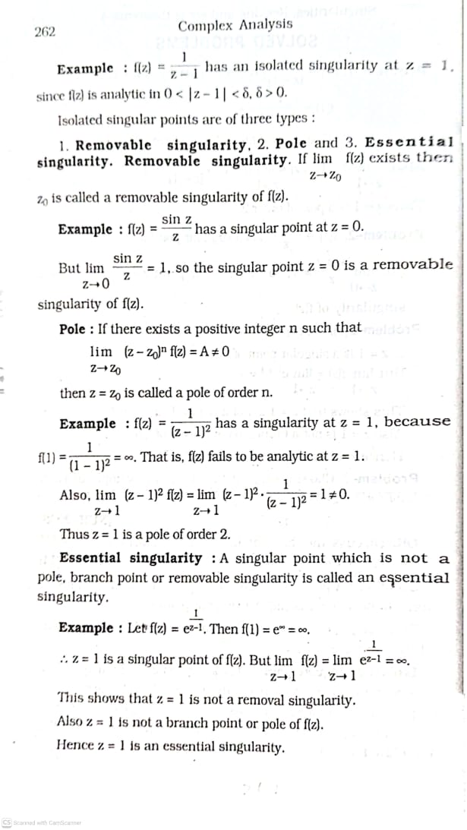

Slide 5
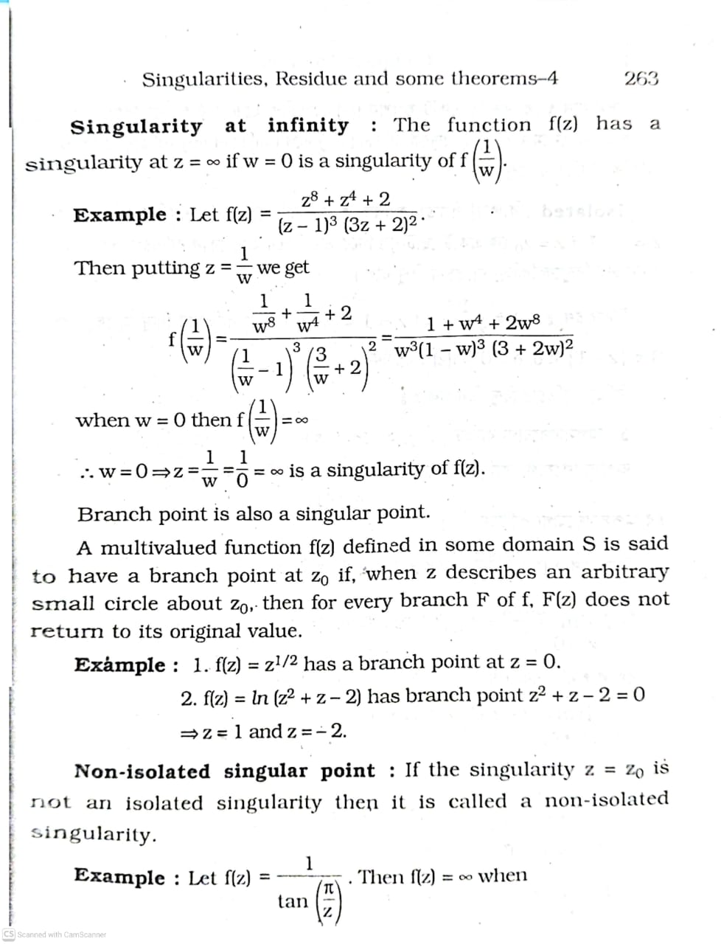

Slide 6
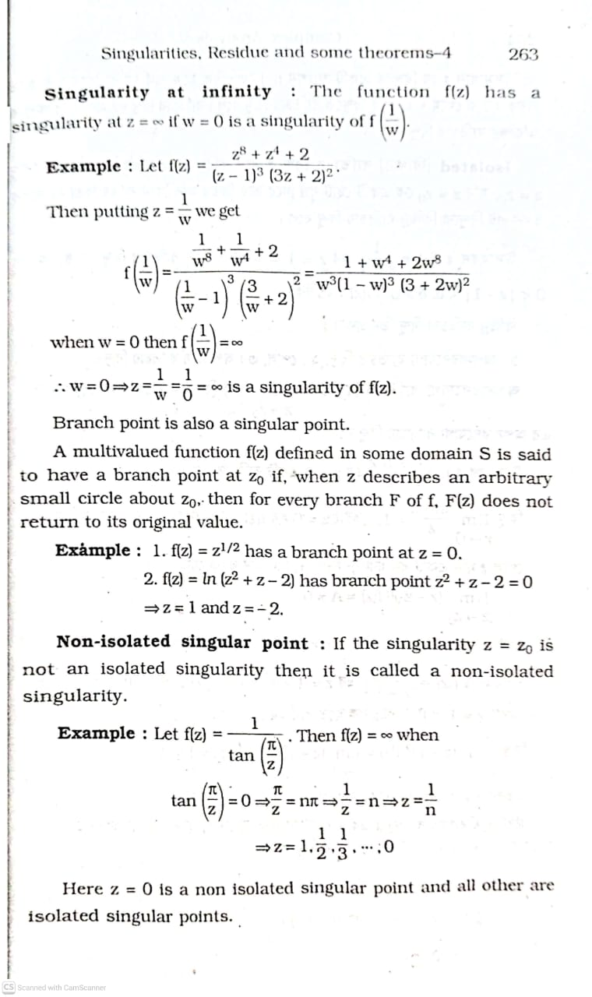

Slide 7
EX-1:

Slide 8
Ex-2

Slide 10
Ex-3

Slide 11
Ex-4

Slide 12
Ex-5

